Slide 1
How to use this document:
This deck includes slides that cover how the ITA and the surrounding approach were created, why it’s a valuable approach, and what’s required of participants.
Add your own context and details and use this to onboard your team. Look for this yellow color as a pointer to important areas to add your own information.
ITA & Sensemaking
The what, why, and how of this approach to having dynamic conversations about equity and student success
[Institution Name / Date]
Notes:
White label slides

Slide 2
BACKGROUND
Access and outcomes
No one needs to convince you that education changes lives. You’re already there, committed to making higher education more accessible and equitable. But we’re always looking for new approaches to help us deliver on that promise.
Thank you for participating in this work—today you’ll learn more about a new approach we’re using to deepen our conversations about and work toward equity and student success.
Notes:
Higher education has long been a major driver of social mobility and economic growth in our country, and making education more accessible to more people creates preferable outcomes for all of us: a more vibrant, equitable society and economy.
College is one promising path to a better life. Everyone should have access to an education that can lead them to meaningful, sustainable jobs and successful lives—no matter their zip code, family history, the color of the skin, or the amount of money they or their parents earn.

Slide 3
BACKGROUND
What is the ITA?
The Institutional Transformation Assessment (ITA) is a process to help postsecondary institutions reflect on existing student success efforts and the organizational structures that support them. It helps an institution learn more about its areas of strength and improvement, which are a critical input to prioritizing and planning further action to enhance equitable student success.

Slide 4
BACKGROUND
Who is participating, and why?
The Institutional Transformation Assessment (ITA) can help us have deeper, more reflective conversations about what’s working to increase student success, and what can be improved upon.
This conversation happens in a sensemaking session that brings together a diverse group of stakeholders from a campus to examine perceptions and set new priorities. You are part of this group: our Transformation Team.
Team Lead:
Name, Title
Intermediary Support: Name, Title
Transformation Team:
Name, Title
Name, Title
Name, Title
Name, Title
Name, Title
Name, Title
Name, Title
Name, Title
Name, Title
Name, Title
Name, Title
Name, Title
Name, Title
Name, Title
Name, Title
Name, Title

Slide 5
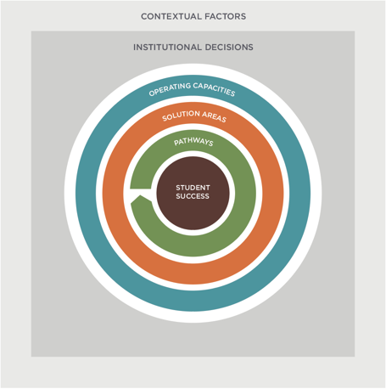
HYPOTHESIS
The foundation of this approach
The ITA is built on evidence that shows that taking an integrated approach to continuous improvement— a cycle of reflection, action, and measurement—is a promising way to support institutional transformation for equitable student success. The hypothesis behind the framework is that a student’s pathway to a credential is supported by solutions designed to mitigate student loss points, which are made possible by strengthening institutional operating capacities. This all exists within the unique ecosystem of the institution and their context on campus. The ITA’s structure reflects this integrated approach. The ITA rubrics cover 11 categories—grouped into operating capacities, solution areas, and pathways—that are all critical for improving student outcomes.

Slide 6
VALUE
How this approach works
The Institutional Transformation Assessment is an online perception-gathering tool. The ITA supports two key activities:
1
2
Gathering input from leaders and practitioners
The ITA has 100+ indicators (questions) over 11 topics, spanning pathways, solutions, and operating capacities.
The ITA’s strength is in its breadth: it’s useful to ask how participants perceive areas of the institution that are outside of their day-to-day job.
Having a dynamic sensemaking conversation
The aggregate (anonymized) responses to the ITA can spark an insightful discussion that digs deep and connects the dots between departments and efforts to reach new insights that can spur action.
The goal is to learn about each other’s perceptions and come to consensus on prioritized next steps.

Slide 7
participants
Who participates in the ITA?
There are two versions of the ITA survey, designed to engage two different groups of participants:
the Transformation Team survey (full 100+ questions from the 11 rubrics)
the Student Success Community survey (abbreviated 30+ questions chosen from the 11 rubrics)
The Transformation Team is a core team of campus leaders who are most deeply involved in and responsible for student success work. They will participate in the full, 100+ question version of the perception survey and the Sensemaking Conversation. The Student Success Community consists of a broader group of faculty, staff, and practitioners from across a campus. They can provide additional perspective by participating in the abbreviated, 30+ question survey. They do not participate in the Sensemaking Conversation, but their perceptions of the institution can be valuable in comparison to those results from the Transformation Team.

Slide 8
This approach
Your role
This visual outlines the process from the facilitator view:
1
Gathering input from leaders and practitioners
2
Having a dynamic sensemaking conversation
PREPARE
DELIVERY
DEBRIEF
Pre-Deployment
Collect Results
Analyze Results
Prep for Sense-Making
Sense-Making Session
Deploy
Debrief
Follow-Up
What’s expected of the Transformation Team?
Participate in onboarding
# of X-hr sessions
Take the ITA
Approx. 1 hr
Save your individual results
Participate in the session(s)
# of X-hr sessions
Lead or support next steps
What’s expected of the Student Success Community?
Take an abbreviated ITA
Approx. 30 min

Slide 9
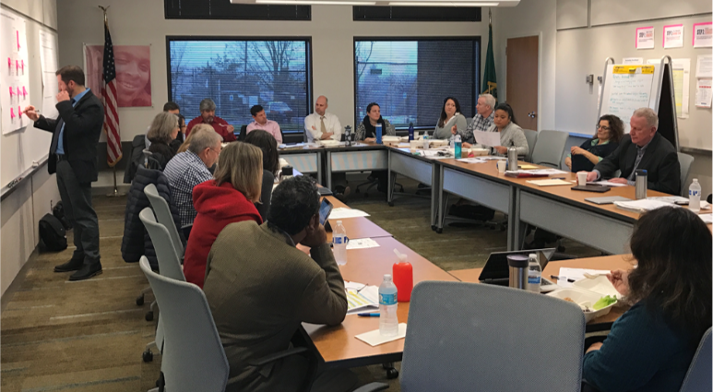
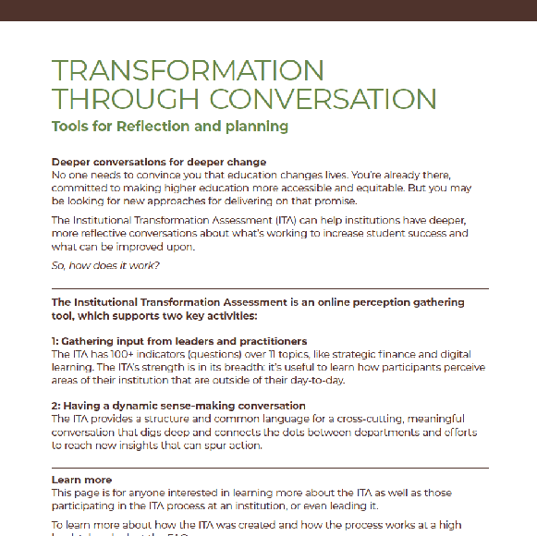
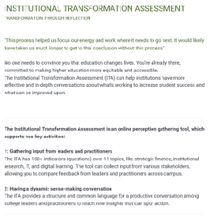
Key Steps
This approach
1
Gathering input from leaders and practitioners
2
Having a dynamic sensemaking conversation
ITA TOPICS
ITA
SENSEMAKING SESSION
2-YR PATHWAYS CCRC
LEADERSHIP & CULTURE Harvard Univ GSE
Who takes the ITA: Transformation Team: 130+ questions, 60 - 90 minutes
Student Success Community (does not participate in sensemaking): 30+ questions, 15 - 30 minutes
4-YR PATHWAYS UNCF
STRATEGIC FINANCE NACUBO
ADVISING NASPA
INSTITUTIONAL RESEARCH
AIR
Who participates in sensemaking: Leaders of this effort and the Transformation Team, made up of campus leaders who are directly responsible for leading or managing (or have expertise in) at least one of the ITA topics
What’s the goal of sensemaking: Having a meaningful discussion driven by the outputs of the ITA—digging deep into areas of convergence and divergence to make new connections and plan
DIGITAL LEARNING Every Learner Everywhere
INFORMATION TECHNOLOGY
EDUCAUSE
What’s the goal of the ITA: Generate aggregate responses that reflect perceptions of performance across all topics and can help spotlight areas of opportunity
DEV ED REFORM
Educ Commission of the States
INSTITUTIONAL POLICY
HCM Strategists
EMERGENCY AID NASPA
STATE POLICY HCM Strategists

Slide 10
KEY STEPS
Understanding the ITA
These topics make up the ITA:
How was the ITA created? Topical experts designed rubrics based on research and observed practices, which were compiled into the ITA. The ITA itself and the process for using it have been informed by six years of formal and informal user research testing with hundreds of two- and four-year institutions and large and small intermediaries.
What does each of these topics contain? Each topic is built on a rubric that contains between eight and 24 questions. The ITA’s strength is in its breadth: it’s useful to ask how participants perceive areas of the institution that are outside of their day-to-day job.
2-YR PATHWAYS CCRC
LEADERSHIP & CULTURE Harvard Univ GSE
4-YR PATHWAYS UNCF
STRATEGIC FINANCE NACUBO
ADVISING NASPA
INSTITUTIONAL RESEARCH
AIR
DIGITAL LEARNING Every Learner Everywhere
INFORMATION TECHNOLOGY
EDUCAUSE
2022
DEV ED REFORM
Educ Commission of the States
INSTITUTIONAL POLICY
HCM Strategists
2022
EMERGENCY AID NASPA
STATE POLICY HCM Strategists
2019 & 2020
Equity review across all rubrics by equityworksNW

Slide 11
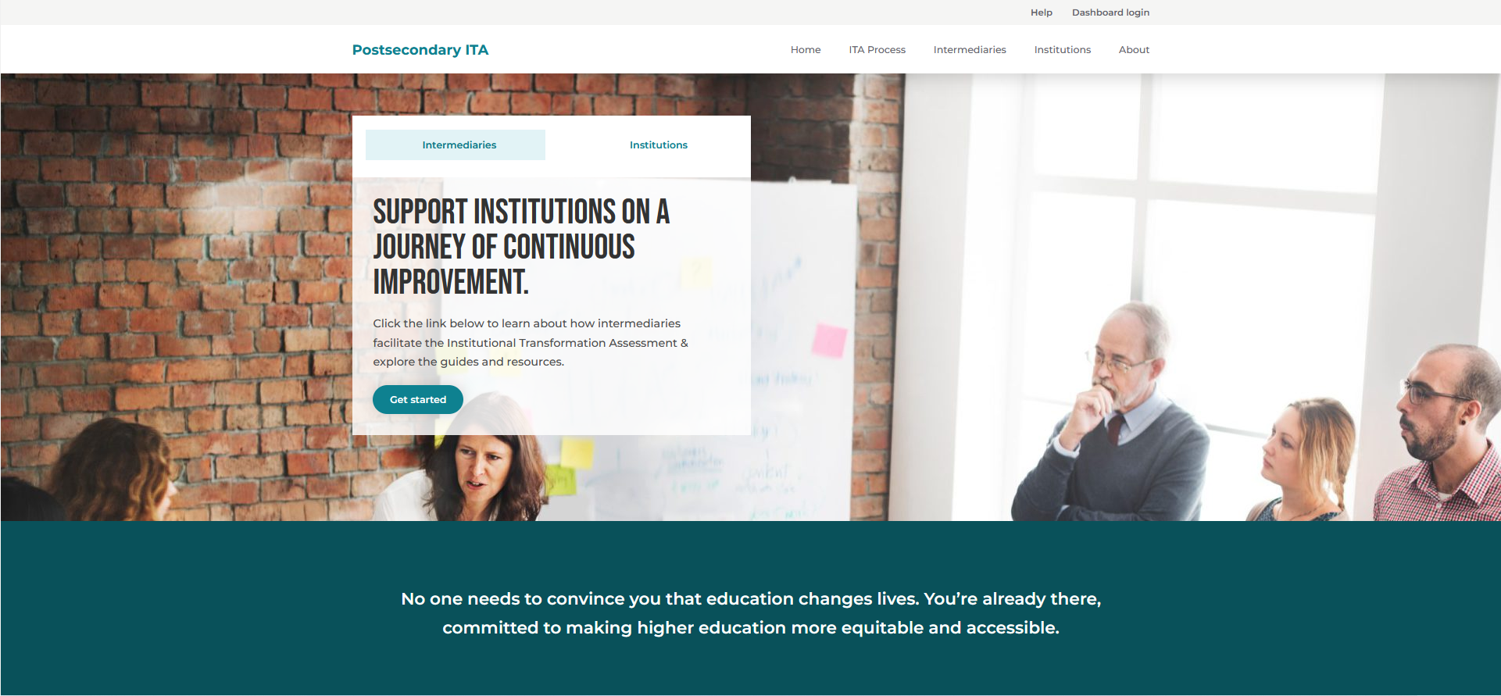
KEY STEPS
Participant support
If you have questions, the ITA homepage has answers. Visit ITA Homepage to find frequently asked questions about how the ITA process, how it was created and how it works to support your institutional goals.
Navigate to the INSTITUTION section for role-specific information about this process. Information includes an overview of the process as well as checklists for taking the ITA and participating in sensemaking.

Slide 12
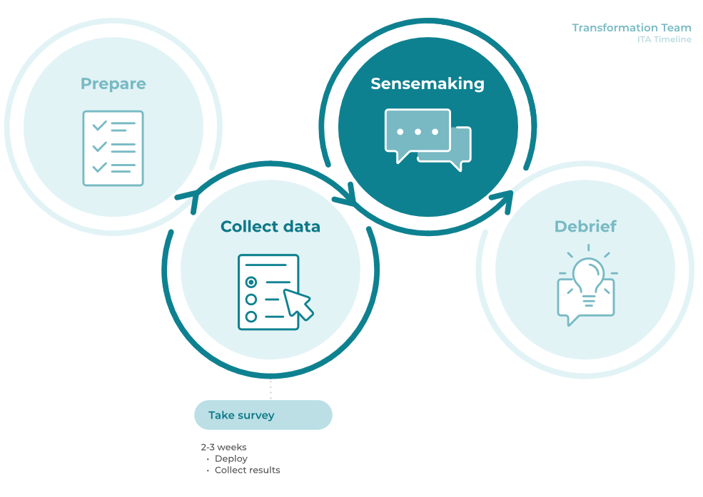
timeline
Taking the ITA

Slide 13
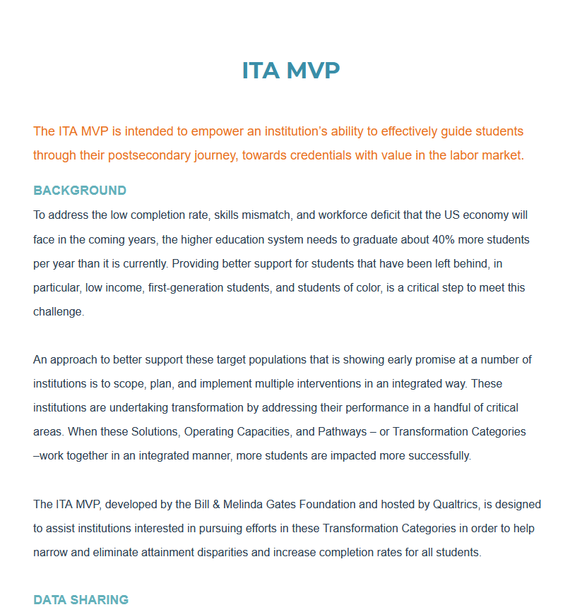
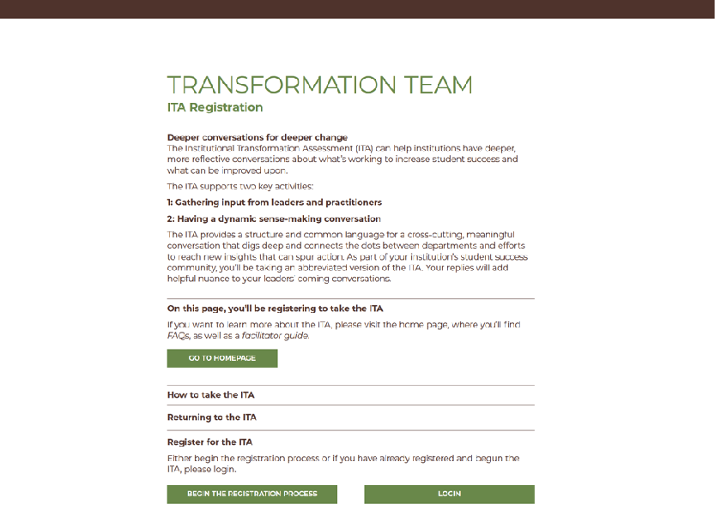
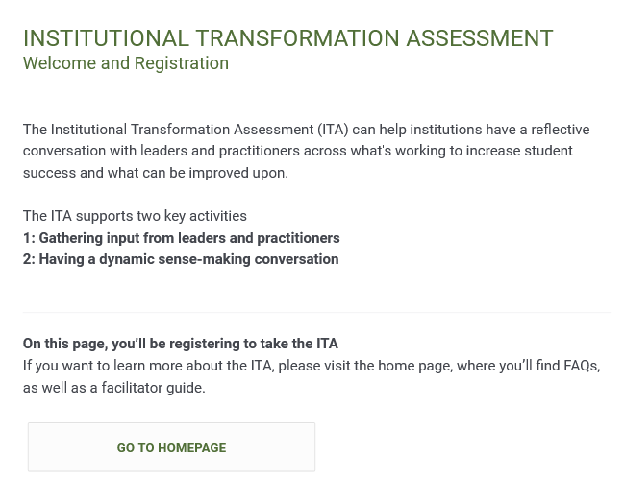
KEY STEPS
Register for the ITA
Register for the ITA using a custom, institution-specific link sent via email
When taking the ITA survey, it’s okay if participants don’t complete the entire assessment in one sitting— there is an option to return and pick up where they left off. To do so, the Return to ITA survey link is needed, which is included in the original invitation email. Alternatively, after a participant registers with the ITA, the system also auto-generates an email to participants that includes the Return to ITA link.
If not found in the email inbox, it could be in the spam folder— email subject is “ITA Return Link,” sent from itaAdmin@qemailserver.com

Slide 14
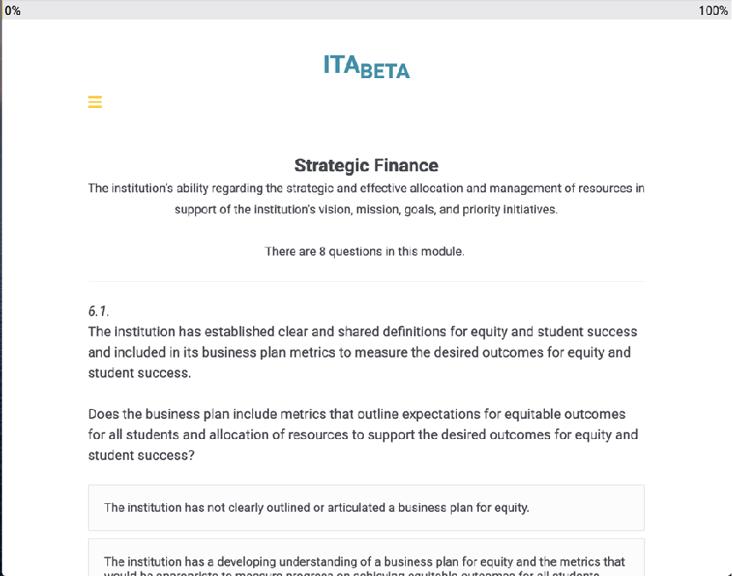
KEY STEPS
Take the ITA
Step through the topics and answer the questions Note that each question (outside of two-year pathways) has a description for four levels of performance. Select the one that sounds most like our institution. Some questions may not be relevant for our institution—in that case, select the “not applicable” option. If you just don’t know, select “I don’t know.”
See example below.
CATEGORY | INDICATOR | EMERGING | DEVELOPING | ACCOMPLISHED | EXEMPLARY | NOT APPLICABLE | I DON’T KNOW
Strategic Finance | Meaningful incentives are used to improve student success and increase equitable outcomes for students. Are effective financial incentives implemented to support the institution's vision and priority objectives, including improving student success and increasing equitable outcomes for students? | Units/leadership within units receive periodic reviews based upon traditional performance criteria (i.e., enrollment, degrees awarded). The institution's revenue distribution formulae may conflict with institutional goals. | Senior institutional leaders recognize the need to align incentives with vision but have not yet developed a campus-wide system for aligning incentives with its vision. | The institution is developing a campus-wide system to accurately monitor, incentivize and motivate individual unit efforts that supports institutional goals, including student success and equity goals. | Effective financial incentives have been developed and implemented throughout the campus to advance the institution's vision and priority objectives, including student success and equity goals.

Slide 15
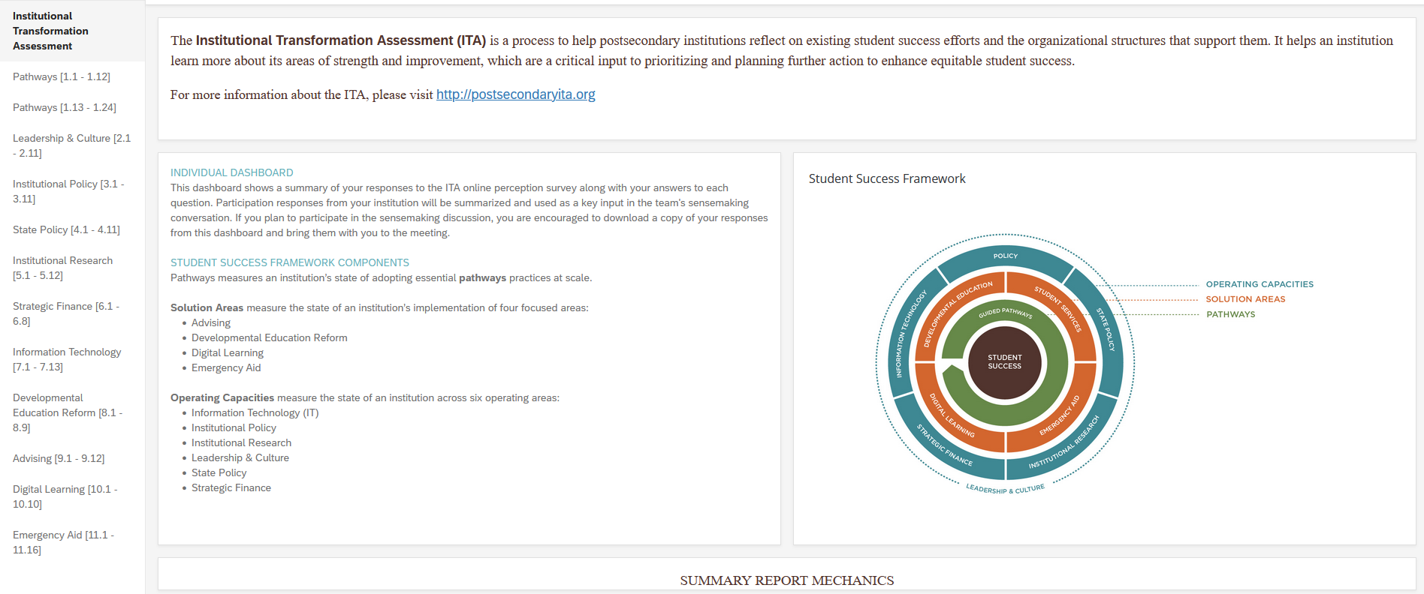
Key Steps
Access your results dashboard
Revisit your personal results Being able to look back on your answers during the sensemaking session will be valuable.
Who can see individual responses? The facilitator dashboard does not store names and email addresses—your responses are confidential.
Who can see an institution’s responses? This depends on the data-sharing agreements established. [Opportunity to add detail here about intermediary / other arrangements.]
IMPORTANT TO KNOW
The data from the ITA is part of a formative evaluation process. In other words, it is not meant to pass judgment or hold institutions accountable for changes in practice, but rather to help institutions learn more about their current state and prioritize efforts for transformation.

Slide 16
OUR SESSIONS WILL BE HELD:
[DATES]
KEY STEPS
Participating in sensemaking
The sensemaking session will help your team explore all of the categories, how they connect, and where there might be opportunity to take action to increase equitable student success.
We’ll work together to answer these questions:
What story do the ITA outputs tell about student success at your institution?
What is the most important thing to focus on that would have significant impact on student success?
What are the 3-5 most impactful actions we might take next?
It’s important to come to this session:
Ready to share your expertise and listen to others
With a sense of curiosity and openness, ready to dig into questions about where there were low, high, or divergent ratings in specific ITA categories and questions
With a grounding in student success and equity efforts to date, so you can help the group build on them to make progress

Slide 17
KEY STEPS
What does sensemaking look like?
In person
Virtual

Slide 18
value
Thoughts from other institutional users
Past participants and facilitators have noted that the ITA…
Is comprehensive across multiple topics
Integrates equity into and throughout questions and rubrics
Efficiently collects responses from leaders and practitioners
Provides useful dashboards from responses for reflection and analysis
Offers a longer and shorter version for different institutional stakeholders, which enables comparisons to enhance reflection about varied opinions
What respondents said about taking the ITA*
100% of respondents ranked the relevance of the ITA to their institution as either “Good” or “Excellent”
90% felt the ITA results accurately represented their institution
100% agreed that the sense-making conversation was a good use of their time (60% strongly agreed)
85% felt the process will inform changes at their organization
“Just getting together in a small but diverse group helped identify what pockets around campus have information and which do not. This really emphasized our need for better communication across campus.” — Transformation Team member
“There were the right people [in the room] to create a culture of sharing and focus the conversation. You need diverse voices to determine what to focus on.” — Dean of Student Support
*User research performed with institutional users; results above are from 2019; sampling of responses

Slide 19
value
How this fits in
This effort supports our efforts to continuously improve outcomes for all students:
PREPARE
REFLECT
PRIORITIZE
ACT
MONITOR
Institution leaders want to review, analyze, and consider student success initiatives and goals
Institution leaders gather information and people to reflect on goals, progress, and plans
Leaders review data, discuss alternatives, and prioritize in order to initiate/proceed with plans to address gaps
Leaders make changes and investments in people, process, and technology in order to address gaps
Leaders monitor progress against goals and support the changes made
Add other examples of meetings or processes
ITA + sensemaking
Add other examples of meetings or processes
Add other examples of meetings or processes
Add other examples of meetings or processes

Slide 20
CONTACT:
[CONTACT INFO HERE]
NEXT STEPS
Calendar
PREPARE
DELIVERY
DEBRIEF
Pre-Deployment
Collect Results
Analyze Results
Prep for Sense-Making
Sense-Making Session
Deploy
Debrief
Follow-Up
For the Transformation Team:
Participate in onboarding
Take the ITA
Approx. 1 hr
Save your individual results
Participate in the session(s)
# of X-hr sessions
Lead or support next steps
DATE(S)
DATE(S)
DATE(S)
For the Student Success Community?
Take an abbreviated ITA
Approx. 20 min
DATE(S)

Slide 21
CONCLUSION
Our shared goal
Thank you for participating in this effort.
We’re excited to explore these new tools and resources to support our work in increasing student success.
On behalf of our institution and the students we serve, thank you for participating.

