Slide 1
FOR THE TEAM LEAD ONLY Please delete before YOU share WITH THE BROADER GROUP
WINTER 2020
After your team’s meeting you can complete a post-Sensemaking survey that includes the questions below—it’s intended as a way to succinctly capture the outputs of your meeting for future reference. You may wish to capture your institution’s responses at the close of your meeting to keep the answers fresh in your mind.
1/ What is the story this consensus output tells about student success at your institution? Briefly describe where your team feels your institution stands now in regards to student success. Are you just starting out? Have you made substantial progress toward your ideal state?
2/ What is the most important thing to focus on that would have significant impact on student success? What is your team’s priority action at your institution?
3/ What are the 3-5 most impactful actions we might take next? What are the additional categories where you might make impactful change? Are some actions contingent on others? What might come next?
All questions have an open field for your responses.

Slide 2
OPTION 1
SENSE-MAKING & PLANNING MEETING
Materials to inform our consensus on next steps
Institution Name
Date

Slide 3
OPTION 2
Materials to inform our consensus ON next steps
Sense-Making and planning meeting
Institution Name
Date

Slide 4
Today’s Objectives
Thank you for completing the ITA. Engaging in a sense-making discussion around the strengths and opportunity areas at your institution identified through the ITA can help inform priorities and actionable next steps.
Our objectives for today:
Discuss results of the ITA and make sense of these results in the context of our current institutional strategies and priorities
Identify areas of high improvement potential AND high priority
Identify actionable next steps

Slide 5
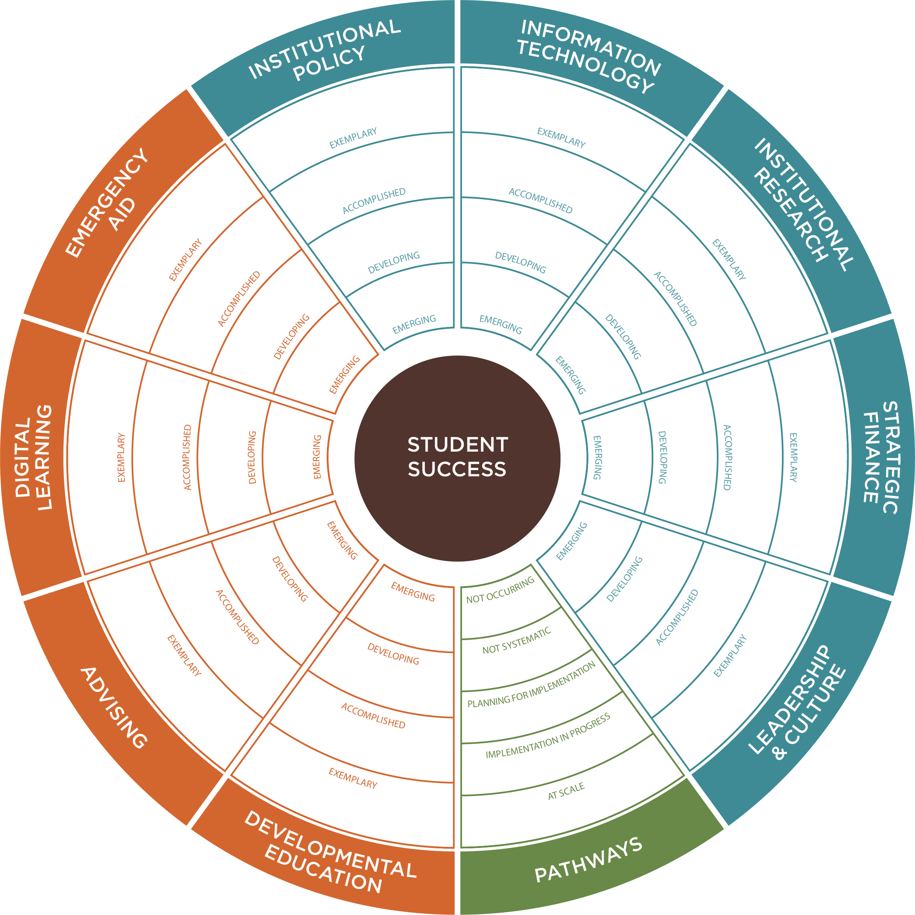
OUR RESULTS
QUALITY OF IMPLEMENTATION | NUMERICAL VALUE
EMERGING | 1
DEVELOPING | 2
ACCOMPLISHED | 3
EXEMPLARY | 4
SCALE OF ADOPTION | NUMERICAL VALUE
NOT OCCURING | 1
NOT SYSTEMATIC | 2
PLANNING FOR IMPLEMENTATION | 3
IMPLEMENTATION IN PROGRESS | 4
AT SCALE | 5

Slide 6
ITA Respondents (2019)
SAMPLE
N=36 (as of 4/27/19)

Slide 7
NOTE THAT DESCRIPTIVE TEXT IN THESE SLIDES IS FOR SAMPLE PURPOSES AND REQUIRES REVIEW/UPDATE FOR CURRENCY

Slide 11
ADVISING
The institution’s focus on assessing and improving advising and support services by leveraging technology, creating student services that are proactive, structured, personalized, and sustained—and connect advising and planning.

Slide 12
ADVISING
The institution’s focus on assessing and improving advising and support services by leveraging technology, creating student services that are proactive, structured, personalized, and sustained—and connect advising and planning.

Slide 13
Developmental Education
EXAMPLE CONTENT
The institution’s capacity for comprehensive and integrated approaches for supporting and expediting students’ progression through developmental education to gateway, college-level course success and completion.
DE Group | Average Rating | 1/2 Rating | 3 Rating | 4 Rating
1. The institution has clear goals and defined measurable outcomes for Developmental Education. | 3 | 31% | 38% | 31%
2. Faculty and Staff Supports: The support the institution provides faculty and staff to improve individual practice and institutional policy for developmental education programs. | 2.6 | 45% | 45% | 9%
3. Acceleration: The way our institution limits students' time in developmental education. | 2.1 | 75% | 17% | 8%
4. Alignment: The degree to which developmental education content is mapped to college coursework. | 2.3 | 65% | 25% | 10%
5. Integration: The way developmental education solutions and associated supports propel students into college coursework in intended program of study. | 2.2 | 62% | 29% | 10%
6. Embedded Student Supports: The way our institution embeds students’ academic and non-academic supports into developmental education instructional delivery and curriculum. | 2.4 | 67% | 27% | 7%
7. Accurate Placement: The way our institution assesses students' academic and nonacademic strengths and weaknesses prior to or upon entry. | 2.4 | 56% | 40% | 4%
8. Refinement: The systems to learn from our reform efforts and how we use those insights to refine reform activities. | 2.2 | 60% | 40% | 0%
9. Scaling: The degree of institutional commitment to developmental education solution's potential to improve academic success and student progression. | 2.3 | 73% | 20% | 7%

Slide 14
Developmental Education
The institution’s capacity for comprehensive and integrated approaches for supporting and expediting students’ progression through developmental education to gateway, college-level course success and completion.

Slide 21
STRATEGIC FINANCE
The institution’s ability to strategically and effectively allocate and manage resources in support of the institution’s vision, mission, goals, and priority initiatives.

Slide 22
STRATEGIC FINANCE
The institution’s ability to strategically and effectively allocate and manage resources in support of the institution’s vision, mission, goals, and priority initiatives.

Slide 25
Institutional POLICY
The institution’s ability to change institutional policies, processes, and procedures to support, sustain, and institutionalize efforts to improve student success and close equity gaps.

Slide 26
Institutional POLICY
The institution’s ability to change institutional policies, processes, and procedures to support, sustain, and institutionalize efforts to improve student success and close equity gaps.

